Slide 1
Get me out of here: Determining optimal policies
Seminar: Cyber Physical systems
Advisor: Christian Pek

Slide 2
Outline
Background and Problem Statement
Fundamentals of Dynamic Programming
Solving the Dynamic Programming equations
Related work and use cases in robot motion planning

Slide 3




Background and Problem Statement

Slide 4

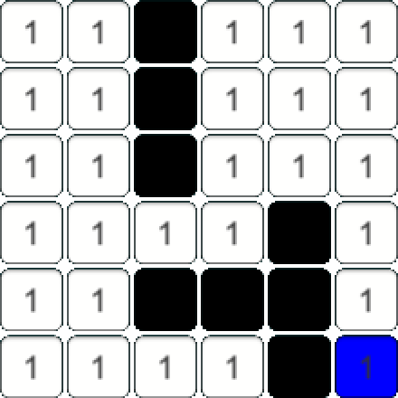

Background
The game labyrinth
Gridmap $M=N^{n × m }$
Walls $M\left(i,j\right)=∞$
Set of exits $X_{goals}$

Slide 5
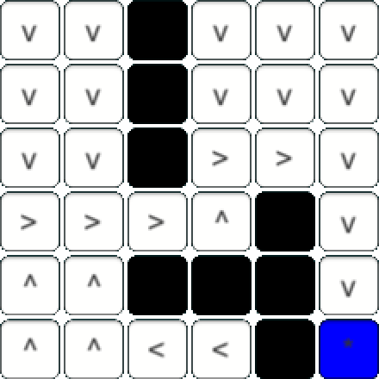


Problem Statement
Determine optimal policies
Function assigning the best possible action to every position in the maze
$P=N^{n×m}→A$
$$→$$

Slide 6
Fundamentals of Dynamic Programming

Slide 7
What is Dynamic Programming
Method used in mathematical optimization
Transforms complex problems into sequences of simpler subproblems

Slide 8
Fundamentals of Dynamic Programming

Slide 9
Solving the Dynamic Programming equations

Slide 10
Solving the Dynamic Programming equations

Slide 11
Solving the Dynamic Programming equations

Slide 12
Related work and use cases in robot motion planning

Slide 13
Related work and use cases in robot motion planning

Slide 14
Related work and use cases in robot motion planning

